Slide 1
Phase 1- Planning And Automation
Saurabh Kandhway

Slide 2

About Me
My name is Saurabh Kandhway . I have around 10 years of Experience into QA Automation role . I am currently working as a Test Architect in one of the Leading MNCs .I have around 5+ years of teaching experience into all the tools and technologies used for testing .I have also worked as Onsite test analyst for 2 years in Melbourne Australia .I am ISTQB , AZ 900 Microsoft Azure Fundamentals, Pcloudy (Cloud based environment for Testing) certified testing professional . I am a certified Simplilearn high Engagement trainer.

Slide 3
Demand for automation test engineer
All the Web Applications may it be JAVA based, .NET based , Peoplesoft or CRM need a Automation framework as it saves a lot of time .
Selenium Supports all the different types of Web Application and since it is a open source the market size for selenium is also huge as compare to others .
In this course you are also learning to create a CT pipeline from scratch which is a current market trend for all the organization.
An increase in demand for testing process automation and solutions that offer a smooth client experience is driving the market for testing automation

Slide 4
What is software testing
Software Testing is a method to check whether the actual software product matches expected requirements and to ensure that software product is Defect free. It involves execution of software/system components using manual or automated tools to evaluate one or more properties of interest. The purpose of software testing is to identify errors, gaps or missing requirements in contrast to actual requirements.
In simple terms, Software Testing means the Verification of Application Under Test (AUT). This Software Testing course introduces testing software to the audience and justifies the importance of software testing.

Slide 5
Why is software testing important
Software Testing is Important because if there are any bugs or errors in the software, it can be identified early and can be solved before delivery of the software product. Properly tested software product ensures reliability, security and high performance which further results in time saving, cost effectiveness and customer satisfaction.
What are the benefits of Software Testing?
Here are the benefits of using software testing:
Cost-Effective: It is one of the important advantages of software testing. Testing any IT project on time helps you to save your money for the long term. In case if the bugs caught in the earlier stage of software testing, it costs less to fix.
Security: It is the most vulnerable and sensitive benefit of software testing. People are looking for trusted products. It helps in removing risks and problems earlier.
Product quality: It is an essential requirement of any software product. Testing ensures a quality product is delivered to customers.
Customer Satisfaction: The main aim of any product is to give satisfaction to their customers. UI/UX Testing ensures the best user experience.

Slide 6
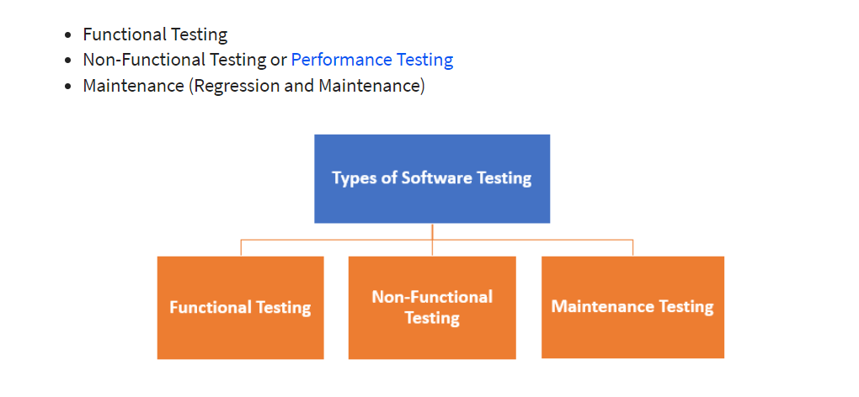
Types of software testing

Slide 7
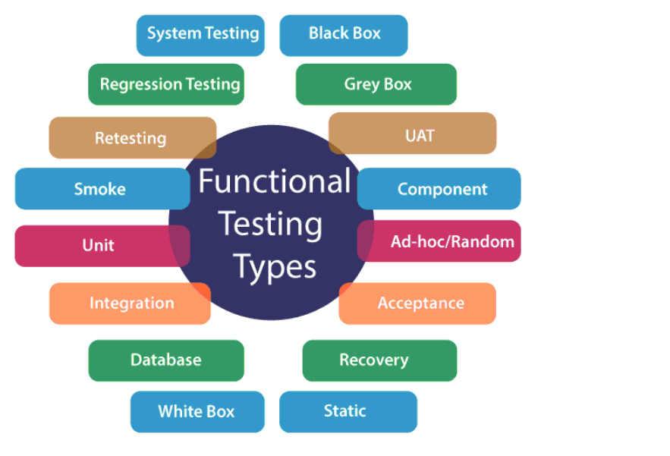
Types of functional testing

Slide 8
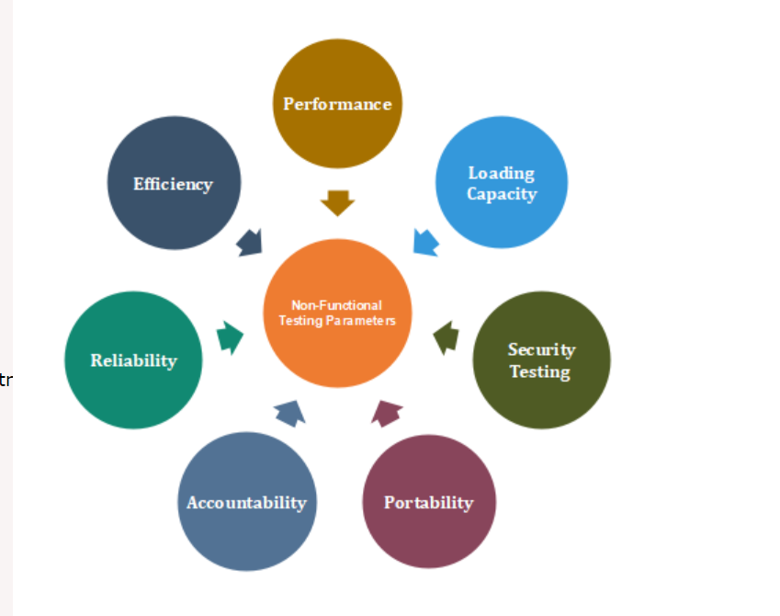
Types of Non functional testing

Slide 9
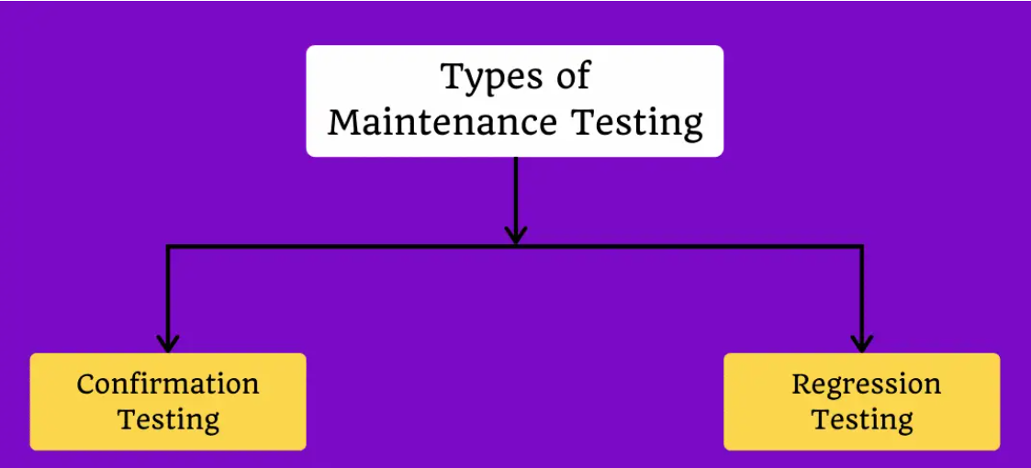
Types of maintenance testing

Slide 10
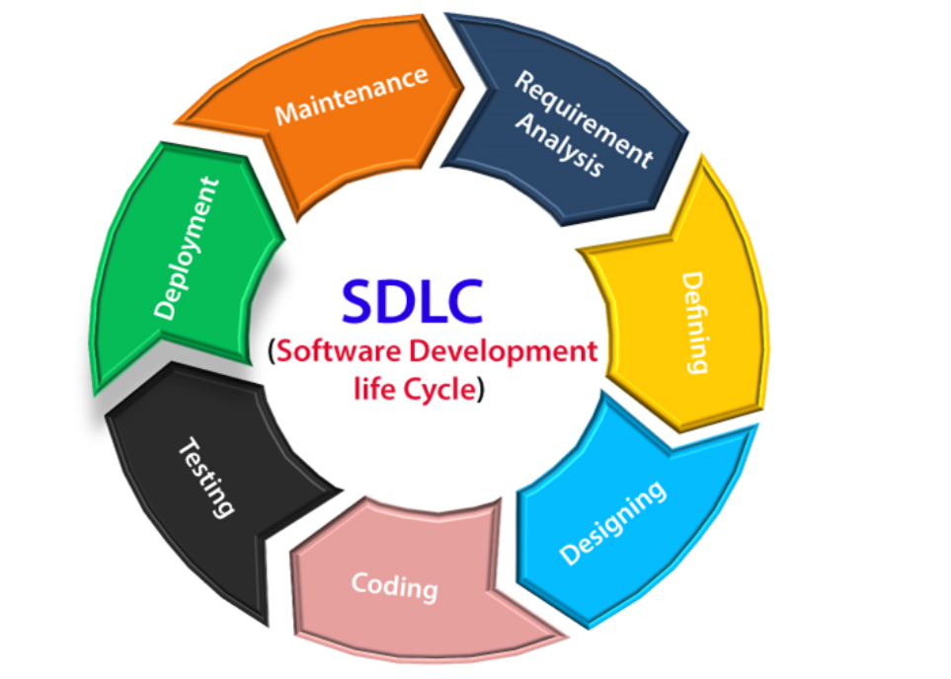
Software development life cycle
A software life cycle model (also termed process model) is a pictorial and diagrammatic representation of the software life cycle. A life cycle model represents all the methods required to make a software product transit through its life cycle stages. It also captures the structure in which these methods are to be undertaken.

Slide 11
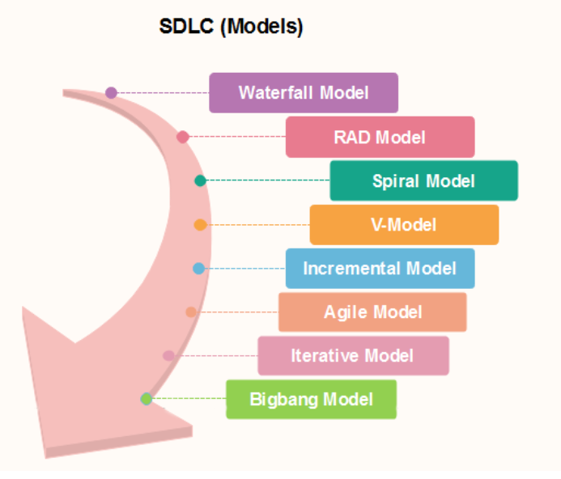
Sdlc models
Software Development life cycle (SDLC) is a spiritual model used in project management that defines the stages include in an information system development project, from an initial feasibility study to the maintenance of the completed application.

Slide 12
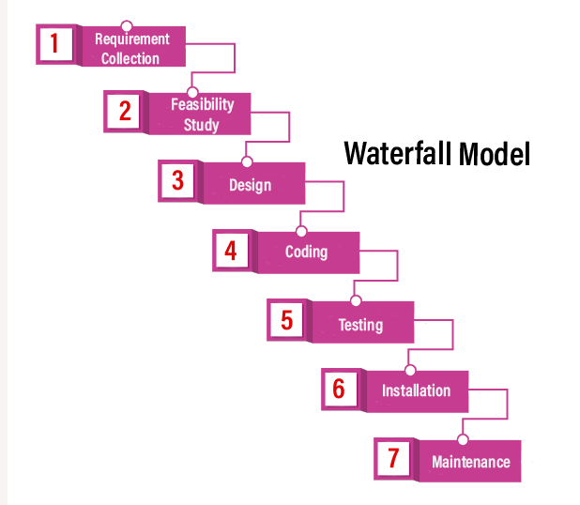
Waterfall model
It is the first approach and the basic model used in software development. It is a simple model that is easy to use as well as understand. The execution happens in the sequence order, which means that the outcome of the one-stage is equal to the input of another stage. That's why it is also known as the Linear-sequential life cycle model.

Slide 13
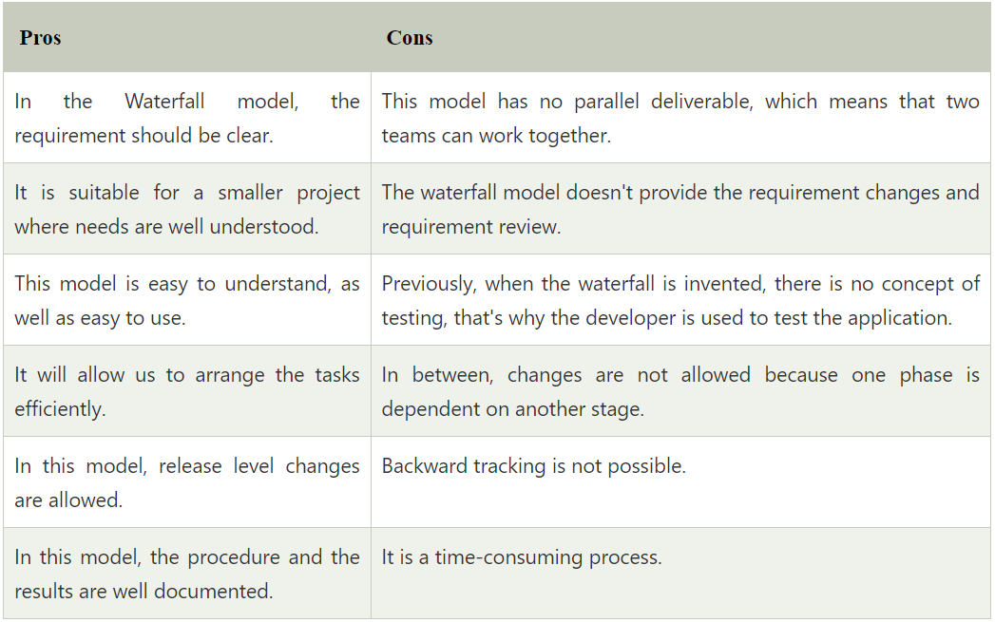
Pros and cons for waterfall model

Slide 14
Spiral model
The biggest problem we face in the waterfall model is that taking a long duration to complete the product, and the software became outdated. To solve this problem, we have a new approach, which is known as the Spiral model. The spiral model is also known as the cyclic model.
In this model, we create the application module by module and handed over to the customer so that they can start using the application at a very early stage. And we prepare this model only when the module is dependent on each other. In this model, we develop the application in the stages because sometimes the client gives the requirements in between the process.

Slide 15
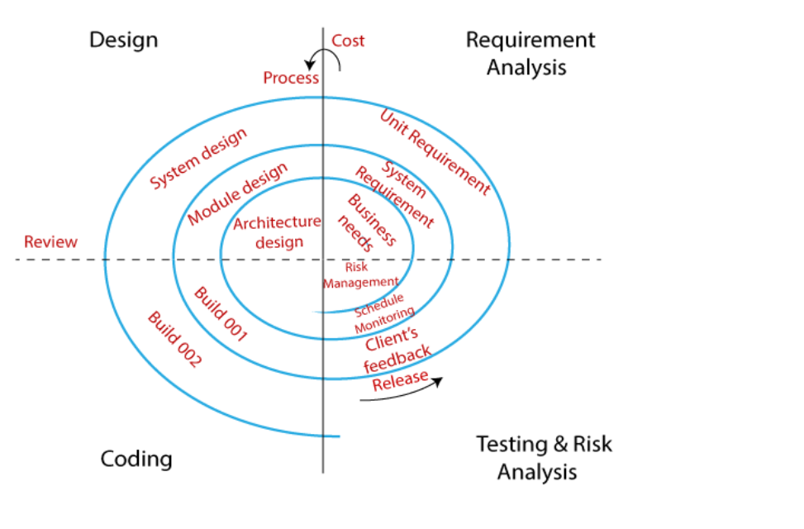
Phases of spiral model

Slide 16
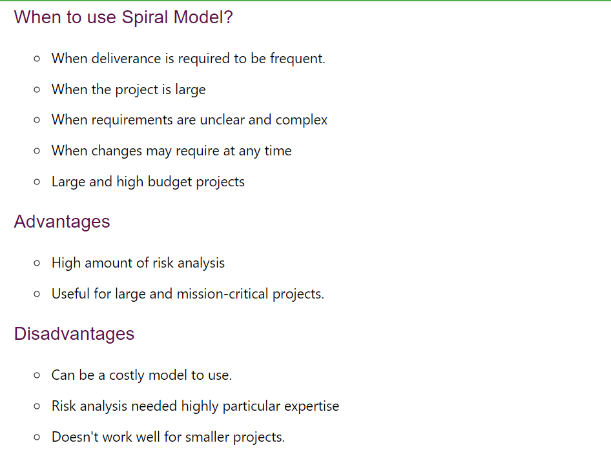
Pros and cons of spiral model

Slide 17
Prototype model
The most significant disadvantage of previous models (waterfall and spiral) is that there were lots of customer rejection that happens after the application was developed, and there was no involvement of the customers in between the project.
Hence, they started the new approach, which is known as the prototype model. In this, we will collect the requirements from the customer and prepare a prototype (sample), and get it reviewed and approved by the customer. And only when they satisfied, we will start working on the original projects so that there won't be any customer rejection.
The prototype is just the sample or a dummy of the required software product. If all the mentioned modules are present, then only the developer and tester will perform prototype testing.

Slide 18
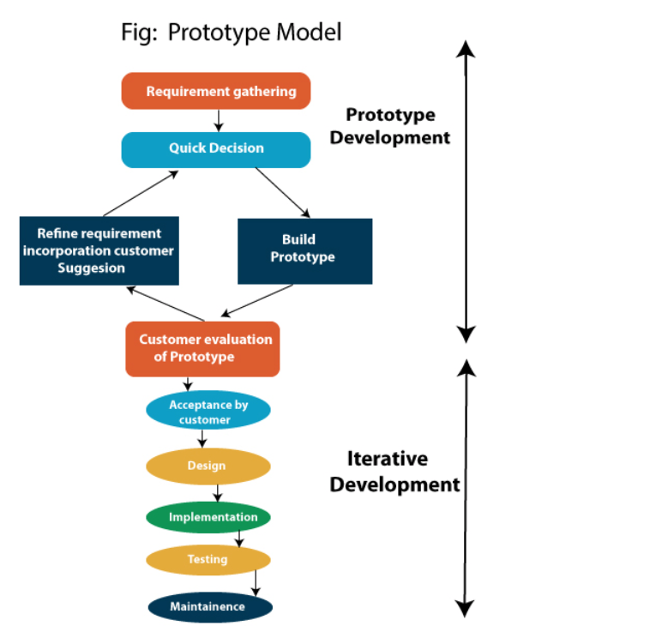
Stages of prototype model

Slide 19
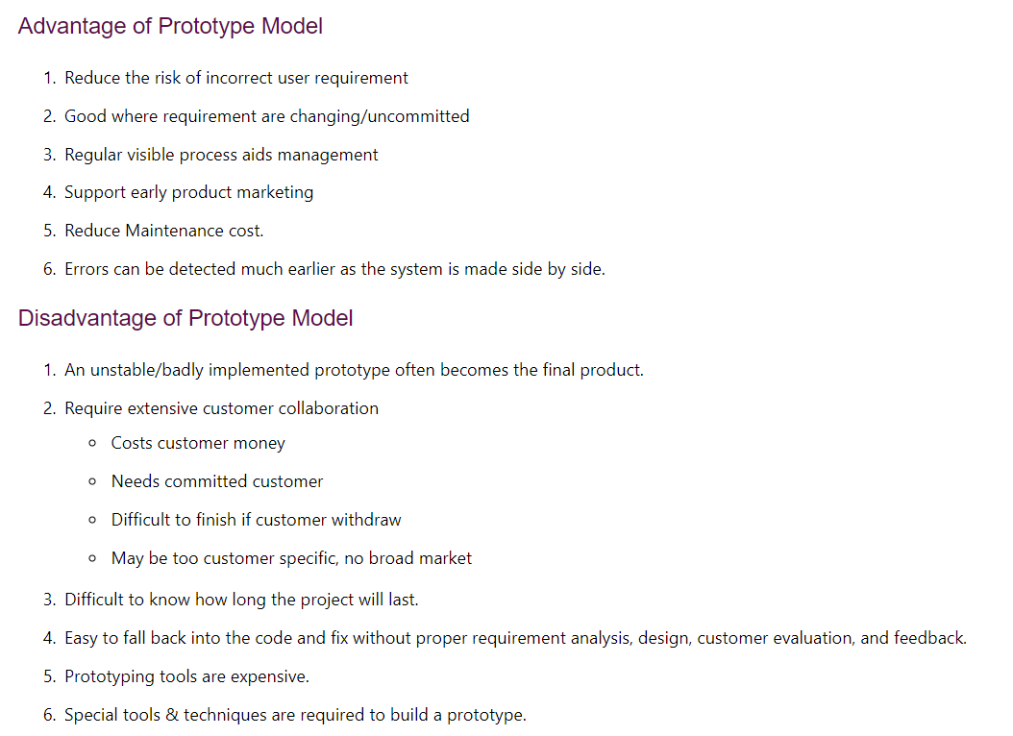
Pros and cons of prototype model

Slide 20
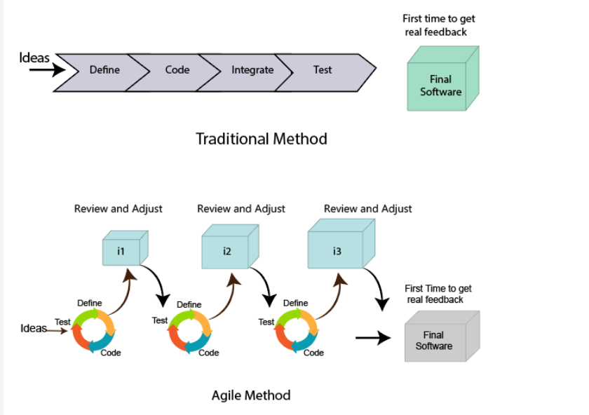
Agile methodology
An agile methodology is an iterative approach to software development. Each iteration of agile methodology takes a short time interval of 1 to 4 weeks. The agile development process is aligned to deliver the changing business requirement. It distributes the software with faster and fewer changes.

Slide 21
What is scrum
The Agile methodology is a widely used approach in software development and other industries where project requirements can change rapidly. One of the most popular frameworks used in Agile project management is Scrum.
Scrum is an iterative and incremental framework that helps teams deliver high-quality products in a timely manner. It is based on the principles of transparency, inspection, and adaptation, and provides a flexible and collaborative approach to project management.

Slide 22
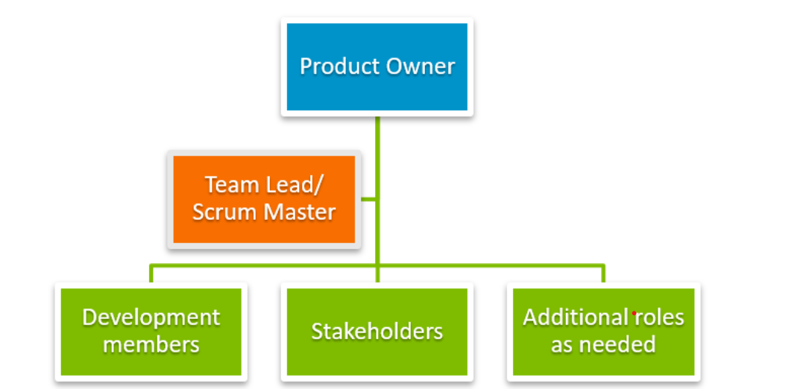
Roles in agile

Slide 23
Product owner
1. The PO represents the stakeholders of the project. The role is primarily responsible for setting the direction for product development or project progress.
2. The Product Owner understands the requirements of the project from a stakeholder perspective and has the necessary soft skills to communicate the requirements to the product development team
3. The Product Owner also understand the long-term business vision and aligns the project with the needs and expectations of all stakeholders. End-user feedback is taken into account to determine appropriate next-best action plans for the development throughout the project cycle.

Slide 24
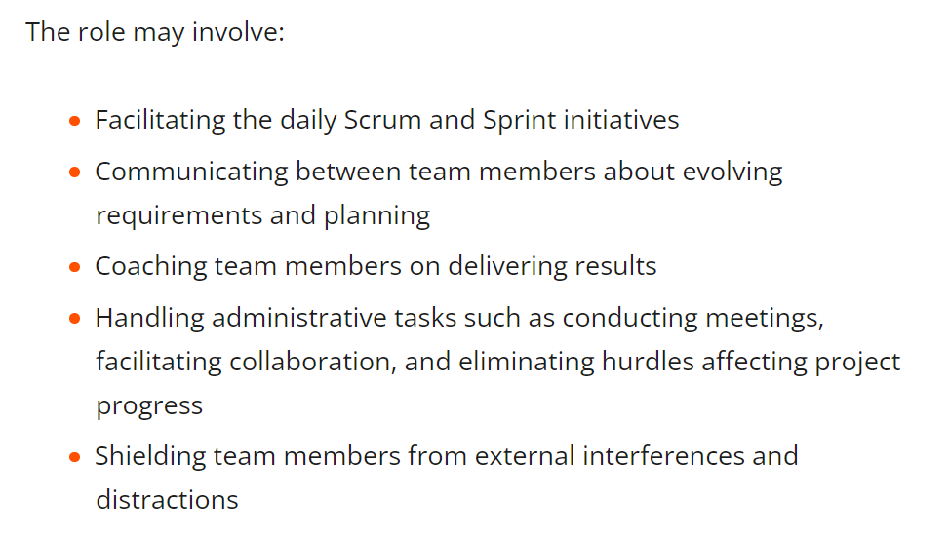
Scrum master
Scrum Master ensures team coordination and supports the progress of the project between individual team members. The Scrum Master takes the instructions from the Product Owner and ensure that the tasks are performed accordingly.

Slide 25
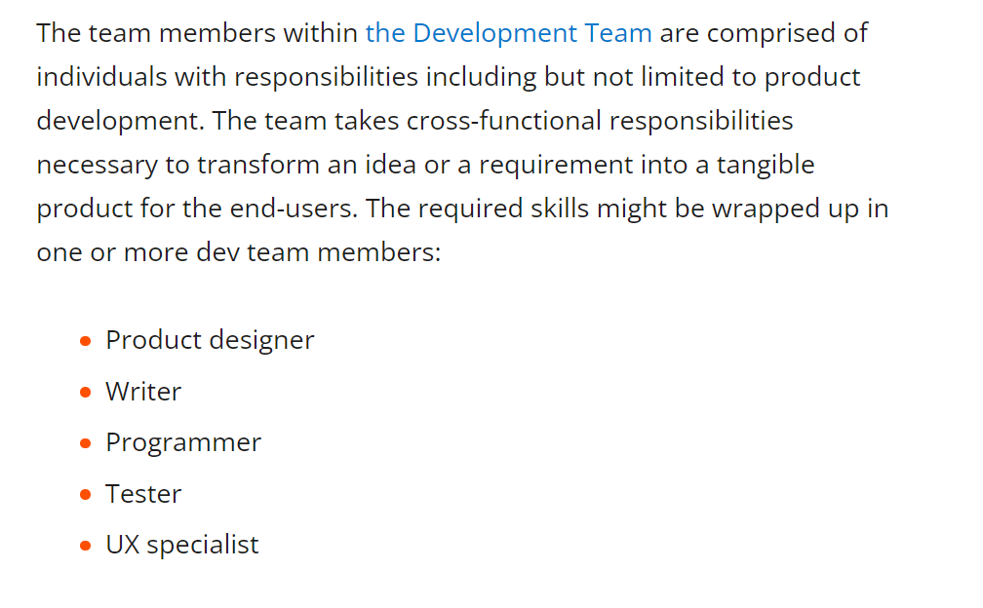
Development team members

Slide 26
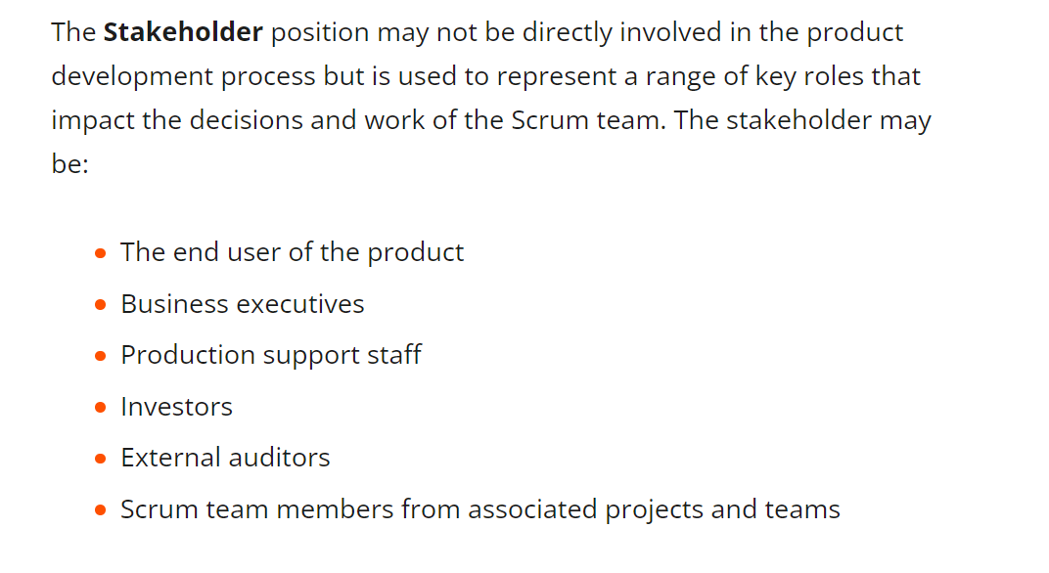
stakeholders

Slide 27
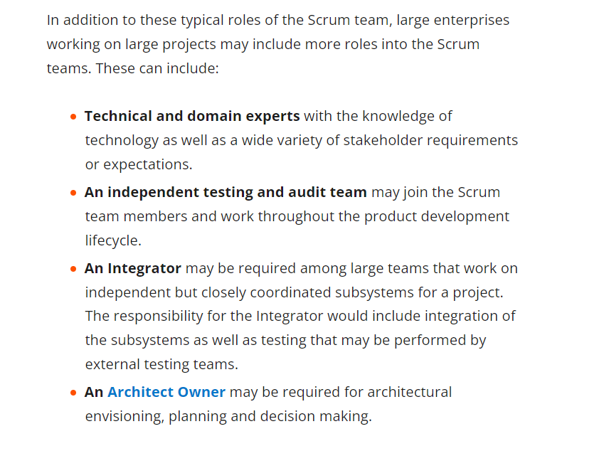
Additional roles for larger scrum projects

Slide 28
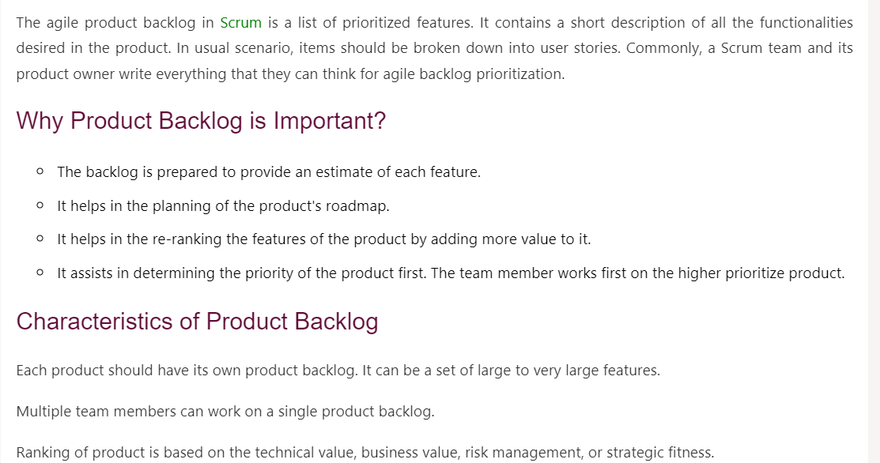
Product backlog

Slide 29
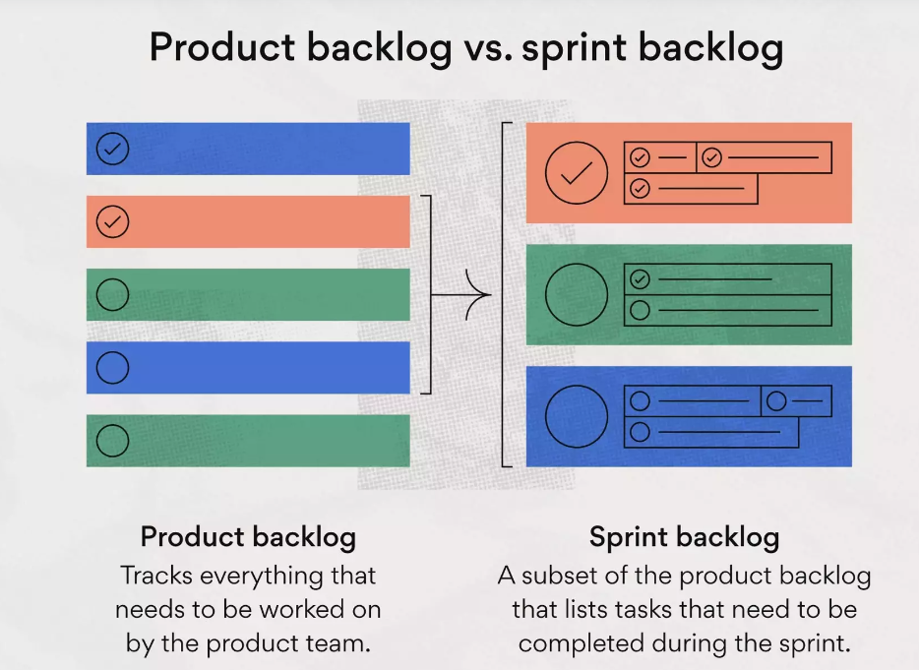
Sprint backlog
A sprint backlog is a list of work items your team plans to complete during a project sprint. These items are usually pulled from the product backlog during the sprint planning session. A clear sprint backlog prevents scope creep by clarifying exactly what your team will be doing—and not doing—during each sprint.

Slide 30
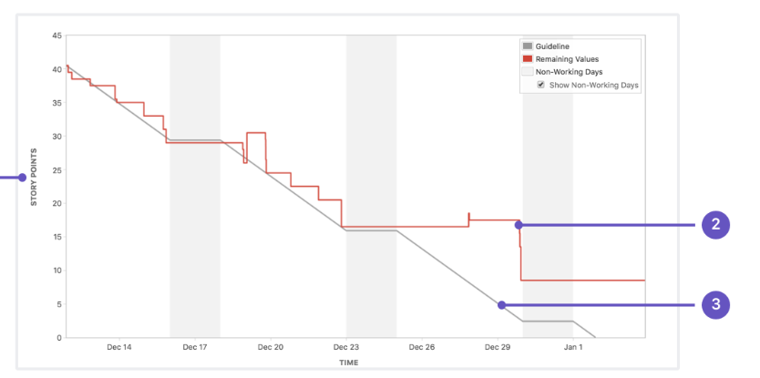
Burndown chart
A burndown chart shows the amount of work that has been completed in an epic or sprint, and the total work remaining. Burndown charts are used to predict your team's likelihood of completing their work in the time available. They're also great for keeping the team aware of any scope creep that occurs.

Slide 31
Agile ceremonies
Daily Standup
The daily stand-up meeting is perhaps the most famous and widely-applied Agile practice. It represents a 15-minute meeting that is held standing up in front of an “information radiator” such as a Kanban board. In practice, it’s almost the same as the Daily Kanban meeting. The only difference is that the agenda of the meeting is stricter in Scrum as every team member should answer the following questions:
“What did I do yesterday?” “What am I going to do today?” “Is there something blocking my progress?”

Slide 32
Sprint planning
The sprint planning ceremony in Agile is a 1-2 hours meeting that occurs at the start of every Scrum iteration/sprint. Its main intent is to populate a Sprint backlog and prepare a Sprint goal by committing to a batch of user stories from the Product backlog.
During the meeting, teams choose the next highest priority items to execute in the sprint. This happens by analyzing their Agile velocity (how many story points they can execute in a single iteration). As part of the ceremony, the development team, the Product Owner and Scrum Master also write acceptance criteria for the user stories and prepare technical tasks for their execution.

Slide 33
Sprint review
Each iteration in Scrum ends with the Sprint Review. During the ceremony, Scrum teams present their finished increment (functionality) to the customer or the Product Owner. The intent of the ceremony is to get external feedback for their work/user stories, add new requirements to the Product backlog or reprioritize it, if necessary.
Each Sprint Review involves the development team, the Scrum Master (Agile coach), and the Product Owner. It’s good practice for the customer to attend the meeting too.

Slide 34
Sprint retrospective
To reflect on what has happened during the sprint, Scrum teams engage in Sprint Retrospectives right after the Sprint Review. The retrospective is a widely-applied Agile ceremony that Kanban teams often use too in an ad-hoc manner.
During the event, teams analyze all problems or impediments that happened during the sprint and look for ways to prevent them from reoccurring. The goal of the retrospective is to continuously engage in “lessons learned” sessions over the course of the project.

Slide 35
Backlog refinement
While being an unofficial Scrum-based Agile ceremony, the backlog refinement cadence is worth briefly mentioning. This meeting can happen towards the end of a sprint. Its main goal is to estimate, add more details, or break down the next high-priority user stories, so they’re prepared for commitment during the Sprint Planning ceremony.

Slide 36
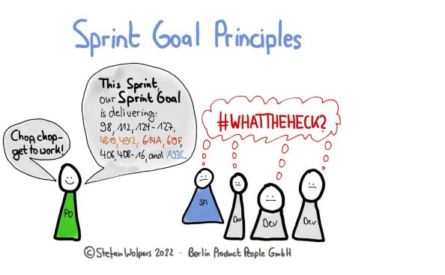
Sprint goal
A short expression of the purpose of a Sprint, often a business problem that is addressed. Functionality might be adjusted during the Sprint in order to achieve the Sprint Goal.

Slide 37
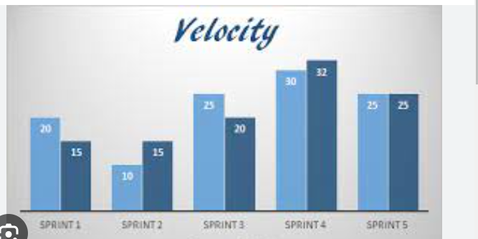
Sprint velocity
An optional, but often used, indication of the amount of Product Backlog turned into an Increment of product during a Sprint by a Scrum Team, tracked by the Developers for use within the Scrum Team.

Slide 38
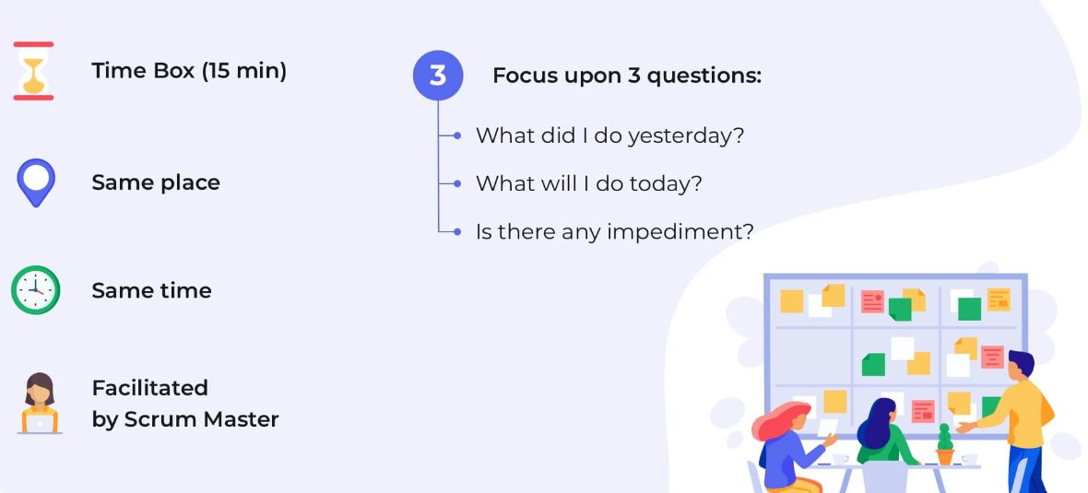
Daily standup call
Scrum Event that is a 15-minute time-boxed event held each day for the Developers. The Daily Scrum is held every day of the Sprint. At it, the Developers plans work for the next 24 hours. This optimizes team collaboration and performance by inspecting the work since the last Daily Scrum and forecasting upcoming Sprint work. The Daily Scrum is held at the same time and place each day to reduce complexity.

Slide 39
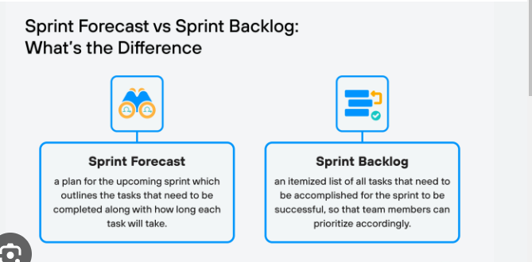
forecast
The selection of items from the Product Backlog Developers deems feasible for implementation in a Sprint.

Slide 40
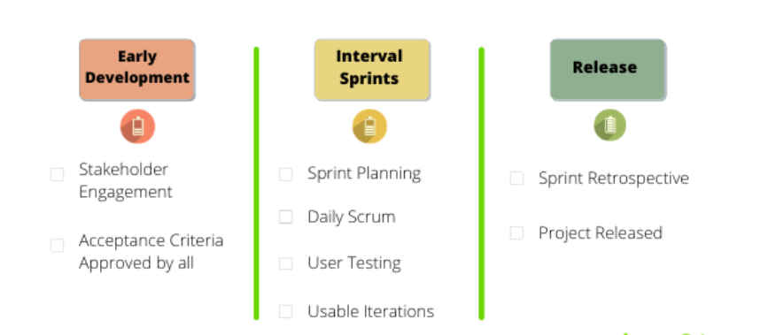
Definition of done
A formal description of the state of the Increment when it meets the quality measures required for the product. The moment a Product Backlog item meets the Definition of Done, an Increment is born. The Definition of Done creates transparency by providing everyone a shared understanding of what work was completed as part of the Increment. If a Product Backlog item does not meet the Definition of Done, it cannot be released or even presented at the Sprint Review.

Slide 41
Jira
Jira is a suite of agile work management solutions that powers collaboration across all teams from concept to customer, empowering you to do the best work of your life, together. Jira offers several products and deployment options that are purpose-built for Software, IT, Business, Ops teams, and more.
Software teams build better with Jira Software, the #1 tool for agile teams. Deliver amazing service experiences across all teams from IT, Dev, Ops, and more with Jira Service Management. Business teams can unlock the power of agile and collaborate better with Jira Work Management. Jira Align is an enterprise agile planning platform that connects work at scale.

Slide 42
Epic in jira
An epic is a large body of work that can be broken down into a number of smaller stories, or sometimes called “Issues” in Jira. Epics often encompass multiple teams, on multiple projects, and can even be tracked on multiple boards.
Epics are almost always delivered over a set of sprints.
Breaking initiatives into epics helps keep the team’s daily work — expressed in smaller stories — connected to overall business goals.

Slide 43
What is bug and defect
Bugs and defects are two of the biggest problems that software and product developers have to deal with. A bug is an error in the software that causes it to malfunction, while a defect is a flaw in a product that reduces its usability or value. Bugs are usually found during testing, while customers find defects.

Slide 44
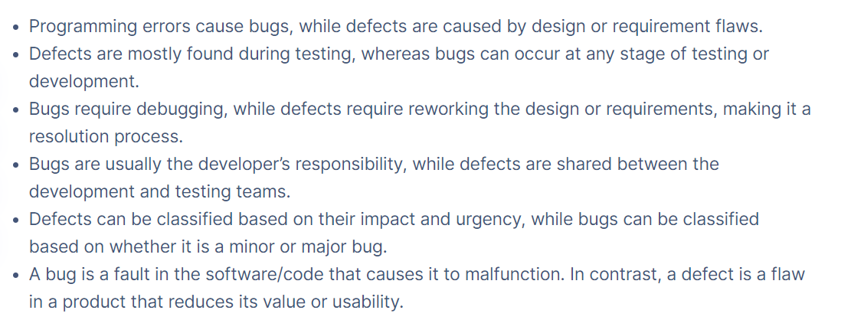
Difference between bug and defect

